Slide 1


Research article writing
By:
DR-Riham F Zahalan
PHD at soil physics - Rural engineering department
Damascus University
Researcher at General Commission for Scientific Agricultural Research- GCSAR- Syria

Slide 2
Importance of scientific writing
All of us researchers, students , prof ..etc need to write and publish our research ( for scientific purposes – for marks – for academic advancement …etc)
and since it takes long time to get reviewed and get the final decision. You have to make sure that your work or paper will meet the demands and standers of the journal you will contact.
a way to write your ideas and what you are trying to do
suitable way to descript your results.
to publish your knowledge and share it with others.

Slide 3
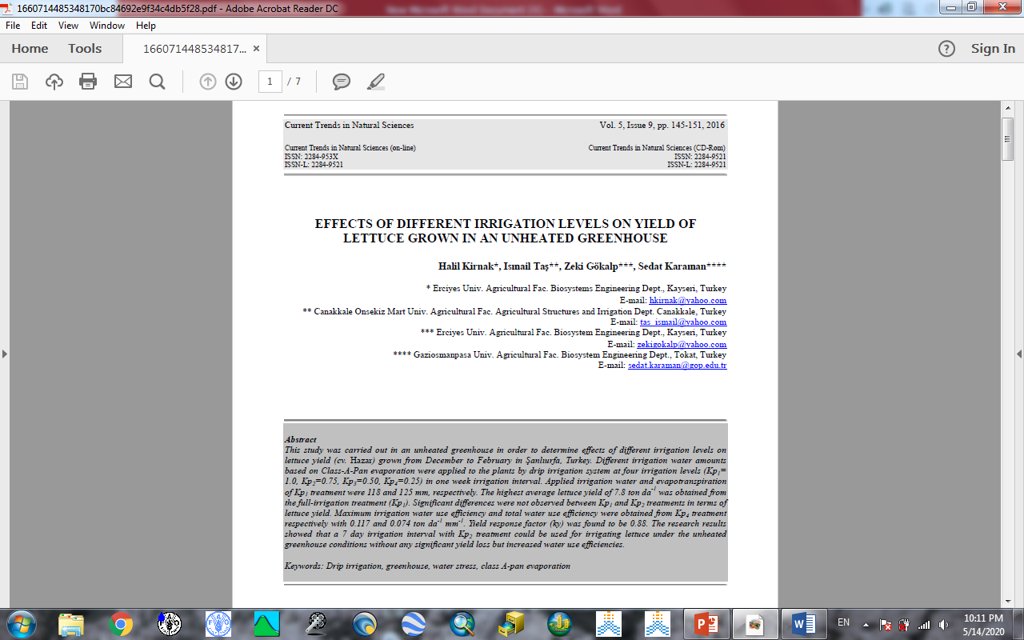
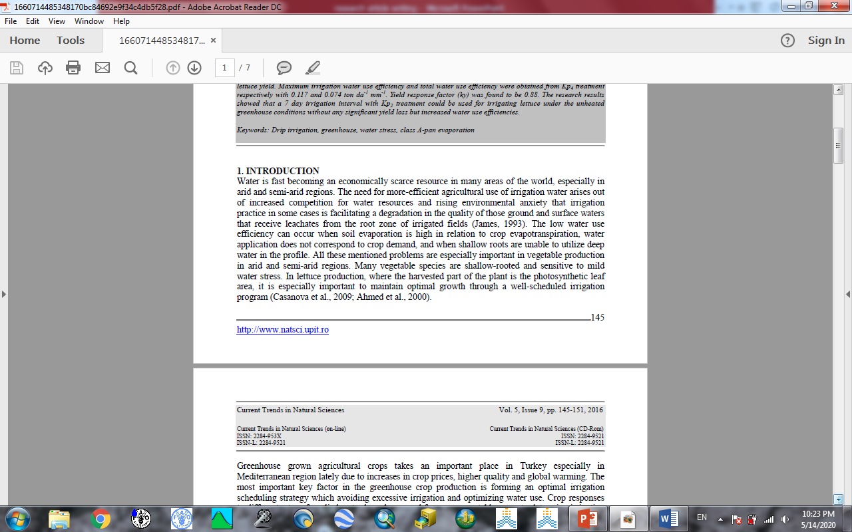
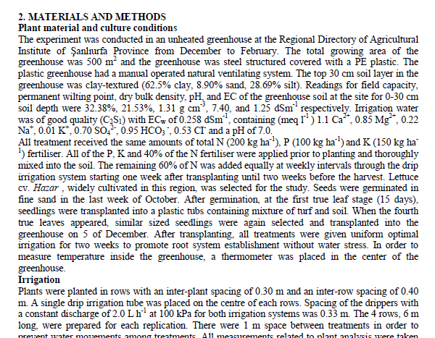
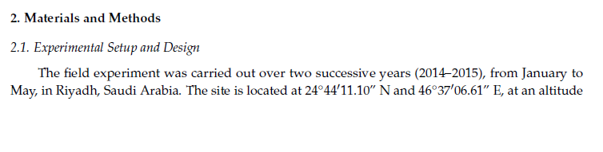
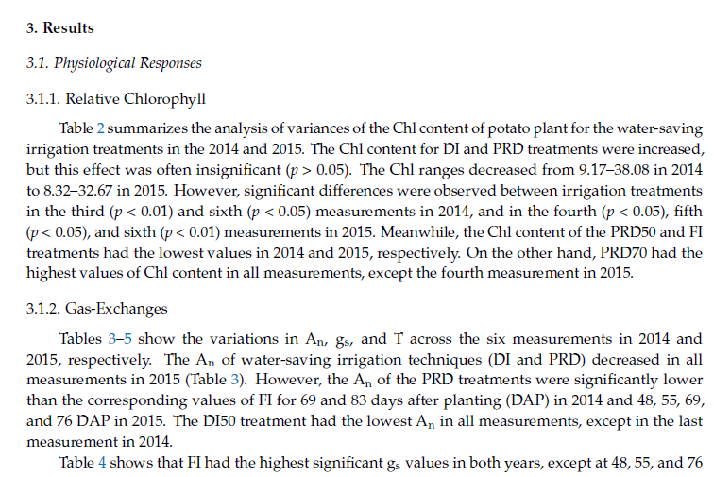
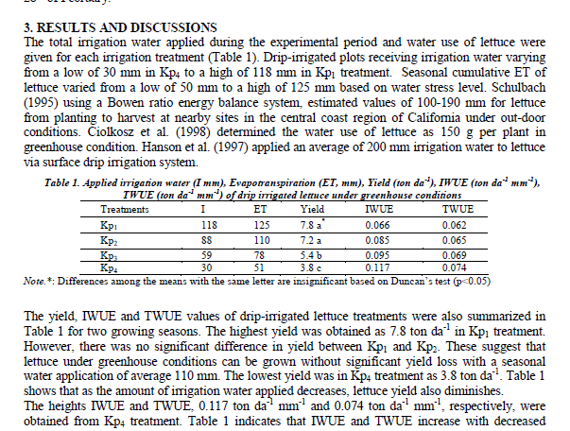
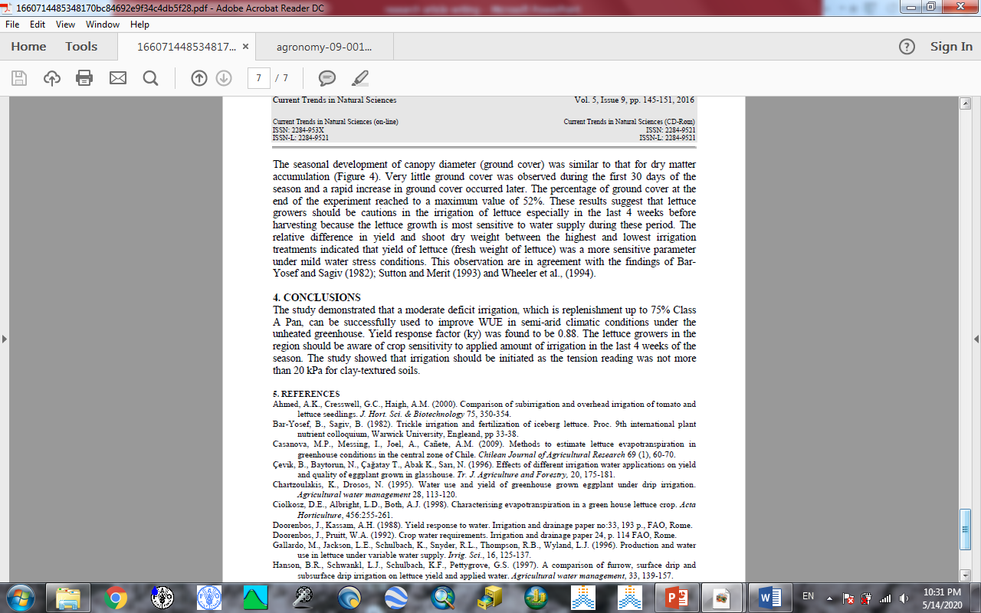
The main parts of a research paper:
Title
Authors
Abstract
Introduction
Materials and Methods
Results
Discussion
Conclusion
References

Slide 4
Main parts of the first page:
Research title : express the main idea about the work.
Author’s names , affiliations , E-mails
Determine the main author to contact with
Abstract: include
type of trial , place , time or duration , statistical design , main idea or treatments , main measurements or studied parameters , the most important results , recommendations.
Key words: the most related words to the topic

Slide 5
The Introduction:
The introduction : the literature review :
1- Collecting data ( Google scholar – libraries – prof ..etc)
Collect papers related to your work (directly or indirectly)
2- writing stages: 3 main stages:
A- Prewriting stage ( collecting information and references).
The longest period ( start early )
B- Writing the first draft ( the main paper body with collected information from stage A)
C- Revision ( checking information – grammar – order …etc)
You can ask for help.

Slide 6
1- Collecting data
1- collecting references reading choose which you need classifying the main topic of each saved part
Finding suitable way to save the citation of chosen references ( like giving numbers )
2- adding similar parts together ( the parts talking about one thing )
You can collect them in word documents with specific names
3- rewriting these parts and emerge them in one logic new part includes the studies agreed with your work and the studies disagreed and why.
4- adding titles to these paragraphs and give them logic order :
From oldest to newest and from simplest to the most complicated
in other words ( write a story ..)

Slide 7


Ideas related to collecting data
Main topics
Results of (Ahmad , 1990) found an increase of 30% in soil bulk density ( from 1).
1 is Ahmad (1990)
Case 1: save the citation of the reference.
Results of (Ahmad , 1990) found an increase of 30% in soil bulk density ( in 1).
Reference from Ahmad (1990)
Case 2: try to get the original reference or you can write the citation and then add ( In: reference no 1)
Number of each references

Slide 8
Writing the first draft
The results:
start with first result , under the first table start writing the main ideas but:
Be carful:
Don’t repeat table’s content in the text ( repetition …rejection ), write the general trend of change and mention the most important things.
don’t use tables and figures to show same results ( choose the most suitable type- easy to understand )
Don’t rewrite the numbers from the table ( find another ways to avoid repetition like, using % of change )
Then : start relate your ideas and give them logic order can make it professional and easy to understand.
try to join similar results together ( increase in BD- FC- TP ..etc)

Slide 9
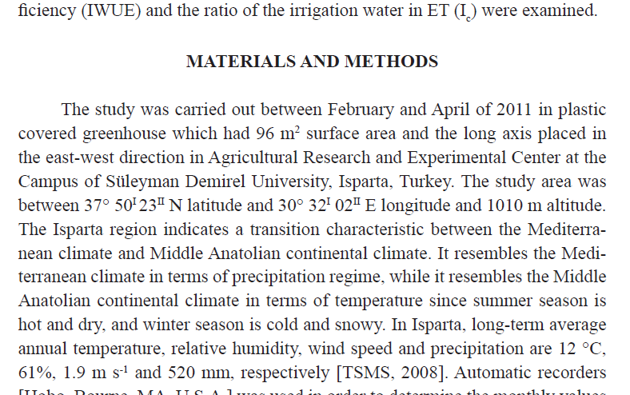
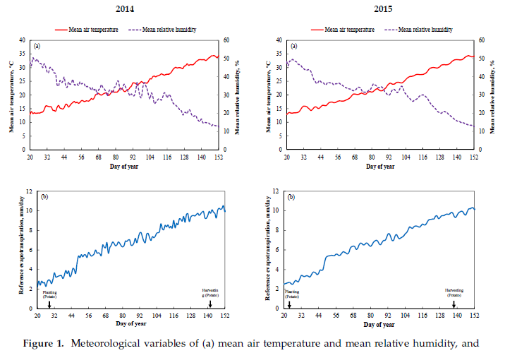
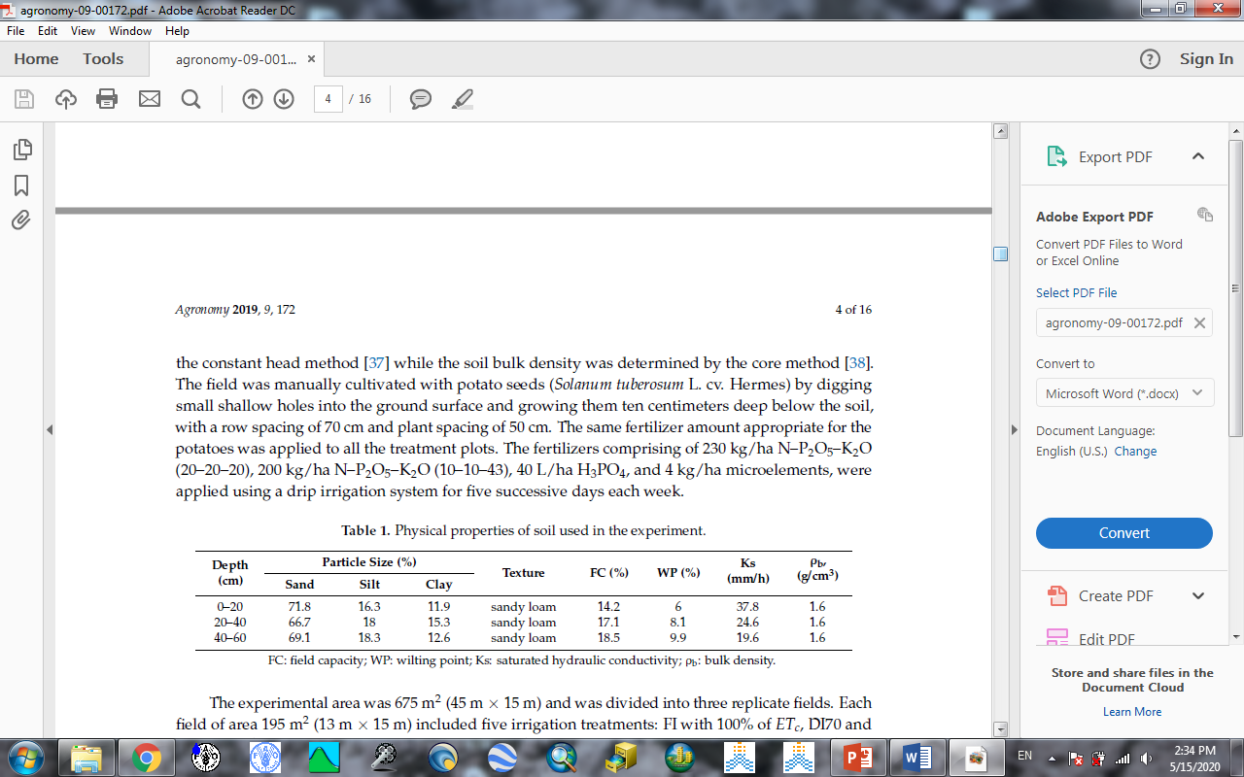
Materials and methods:
It consider the most important part of the research:
Wrong methods or equations …..wrong results….paper rejection
descript your methods so : understandable and able to be repeated and get similar results.
choose the journal before writing: one part or subtitles.
you can use tables and figures to descript
experimental conditions

Slide 10
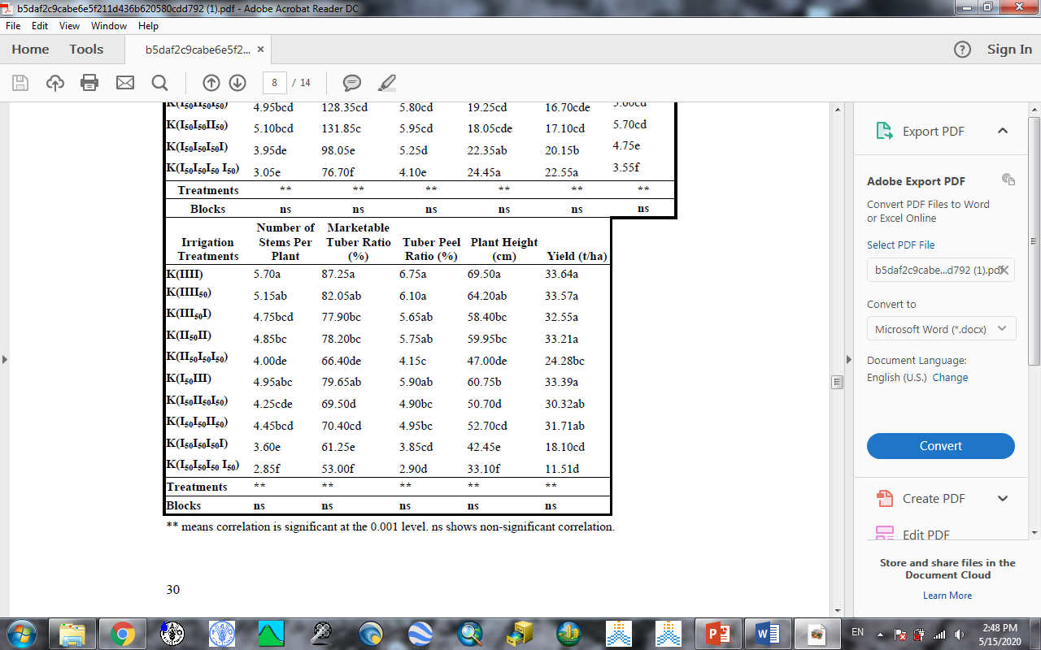
Notes:
use standard methods.
the newest and most advances methods.
use references you searched for to collect needed information about things you are studying.
Get the original references of the method.
statistical design: type – treatments – replications (make sure it can be analyzed)
Statistical analysis: type – program - version
- using additions like Duncan letters.

Slide 11
Introduction structure
the aim of the introduction is to convince the reviewer or the reader and show the importance of this paper.
we build it be writing the known information about the topic ( what previous studies discover and report about it).
the new thing this study will add
objective of the study ( aim or aims )
its importance in the future ( open new door- give new opportunities )
will help to grow potato in dry areas ..etc.
ideas order should be from old to new , and from simple to complicated.

Slide 12
Abstract
Very important: The first you will read after the title:
Most of researchers decide in depend on the abstract if you will continue reading or not.
some journals ask for detailed abstract while other prefer short one (100-300 word ).
6 paragraphs.

Slide 13
Discussion
It consist of 3-6 paragraphs : The final big picture of the results
Writing an attractive story by finding the relations between the studies parameters ( interesting to read – logic to understand).
Discussing with previous studies ( agree or disagree and why)/ ( from old to new).
Put your findings between ( previous studies and studies will be continued of accomplish in the future).
don’t be afraid of mention unique and unpredicted results ..find possible explanations.

Slide 14
conclusion
One paragraph :
First sentence : about the importance of the study
The most important result
The unique of this result
Possible application to this result and if there are any missed parts should be covered in the future.
The questions should be answered in the future and If you need further studies on other related issues

Slide 15
order of writing
After Collecting data and analyze it
Writing the results
the materials and methods
Introduction
Discussion
Abstract
Title
authors
References
Tenses of writing: simple past (for ended actions and studies)
simple present ( for descripting results)
Passive voice ( for methodology )

